Slide 1

Auto Marking Program Guideline
OpenFlow-server Test

Slide 2
How to test ?

Slide 3

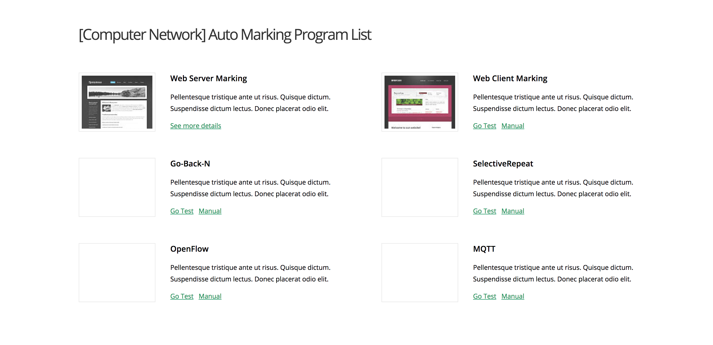
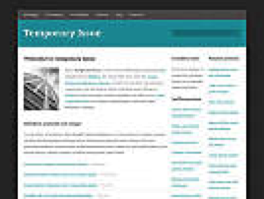
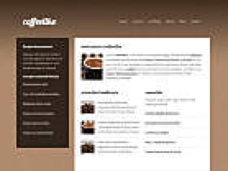
Step 1. Enter 166.104.143.225/index.html in URL of your web browser.

Slide 4
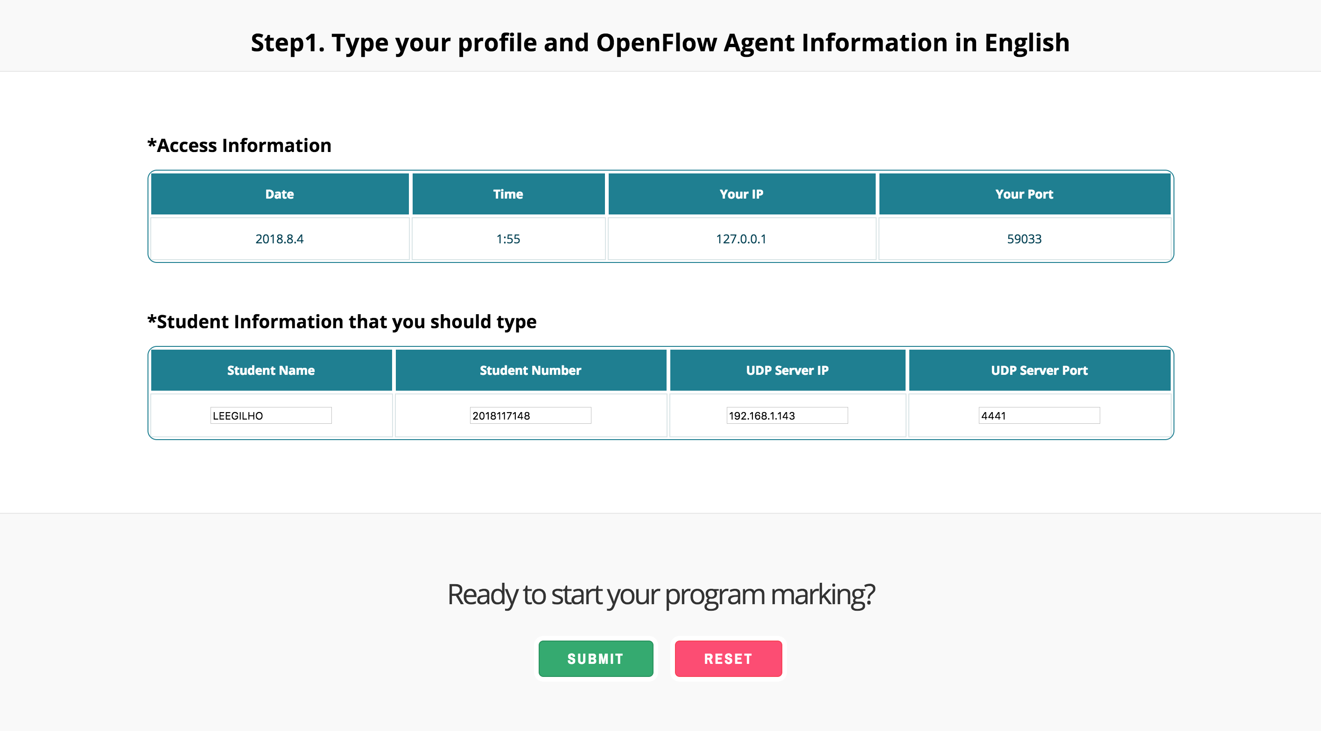
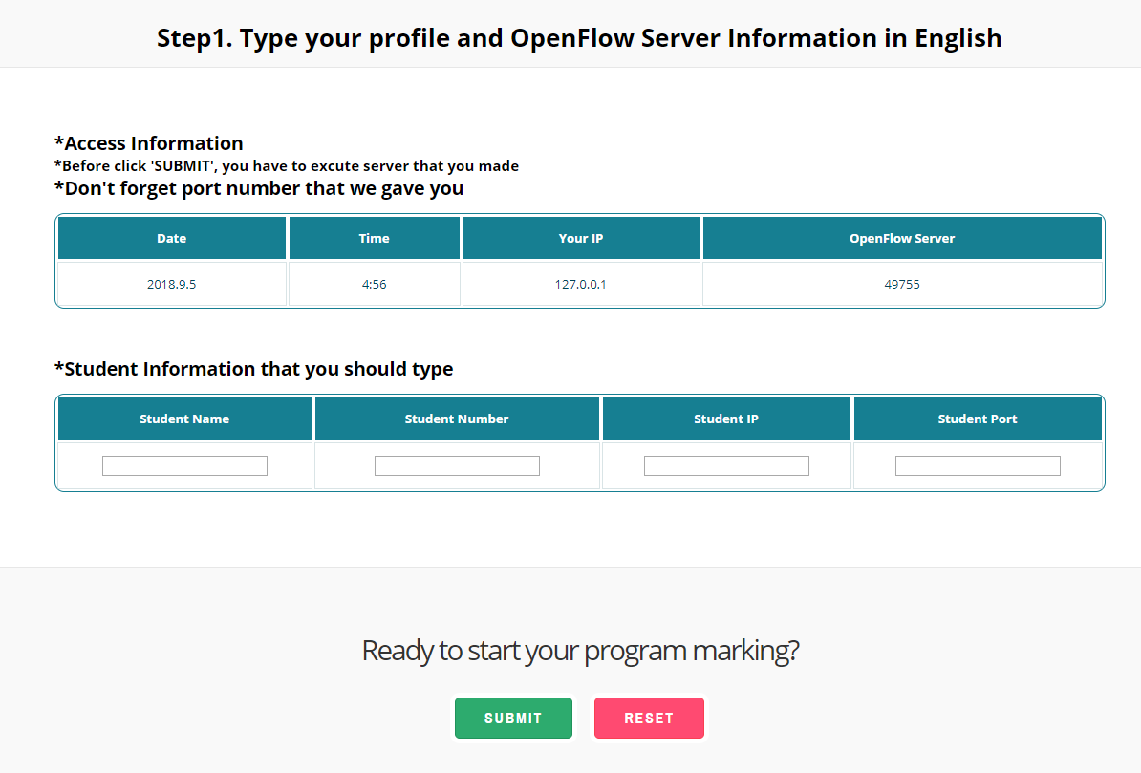
Step 2. Input your information on blank
You can see a information about port, tou have to use this port number on your server program to setting for send to marking server Before click the submit button, you have to run your server and client.
Fill out your information on blank

Slide 5
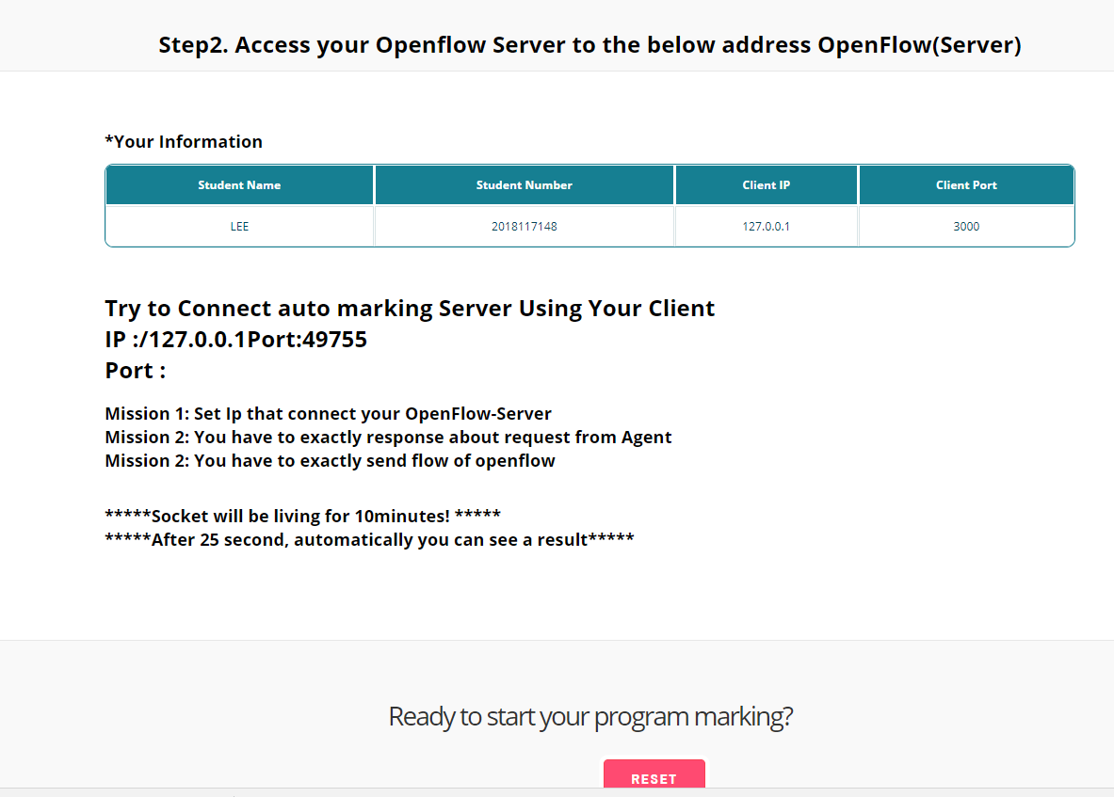
Step 3. Connect your client to server of auto-Marking
In Step 3, the student tries to connect to the server of the automatic scoring program
You should send the correct response for the message sent from the server.
You must follow the flow order of Openflow message.
After 25 seconds, it will show the result automatically.

Slide 6
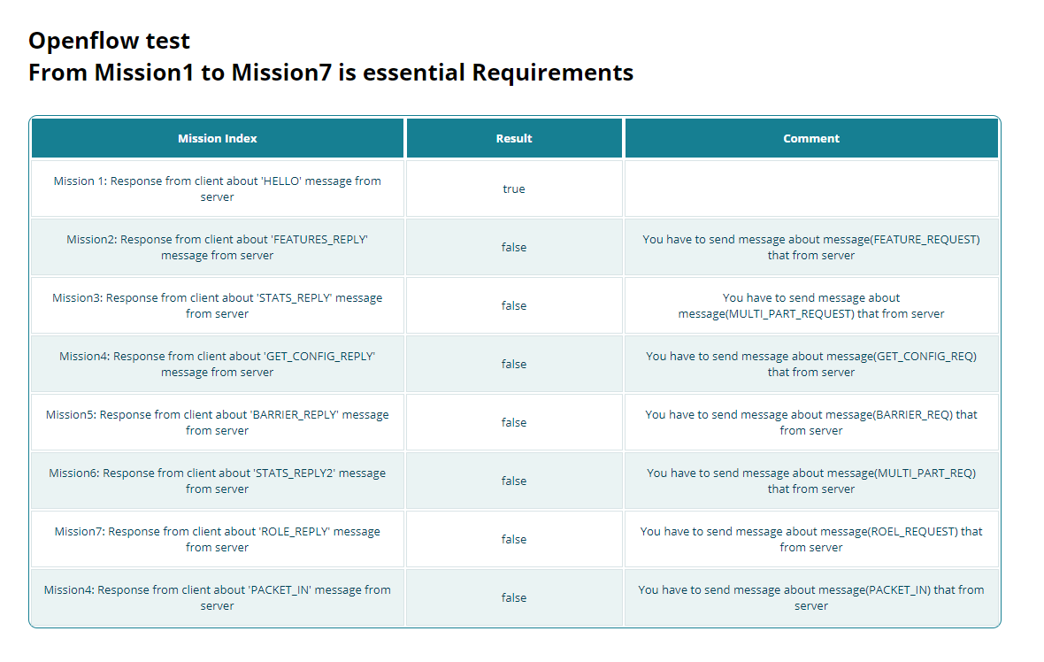
Step 4. Check your result
You can see the implementation results between the client and the server and see the reason of fail.

